Slide 1
Curriculum Committee 2016-17 Annual Report
Notes:
Updated 8-18-15, 2015

Slide 2
Curriculum Committee Membership
Terry Mackey
Dru Urbassik
Megan Feagles
Bill Waters
Tara Sprehe
MaryJean Williams
Jeff McAlpine
Carrie Kyser
Brenda Marks
Tracy Nelson
Lupe Martinez
Ryan West
April Smith
Dustin Bare
Sue Goff
Lars Campbell
Bev Forney
Barry Kop
Jackie Flowers
Lilly Mayer
Cynthia Risan
Dave Bradley
Carol Dodson
Laurette Scott
Shelly Tracy
Elizabeth Carney

Slide 3
Curriculum Committee Mission
Mission/Charge
In supporting the mission of the College, the Curriculum Committee oversees
the quality and content of course outlines and transfer and non-transfer degree
and certificate requirements in accordance with the policies and guidelines
of the Northwest Commission of Colleges and Universities (NWCCU)
and other relevant agencies.
The committee provides guidance, advocacy, and oversight for curricular issues
that are cross-departmental or institutional in scope and impact.
The Curriculum Committee works with:
the Curriculum Office,
Instructional Standards & Procedures (ISP) Committee,
the Assessment Committee,
and other college entities as necessary.

Slide 4
New Courses: 23 New Programs: 3 Program Amendments: 40 Program Suspensions: 8

Slide 5
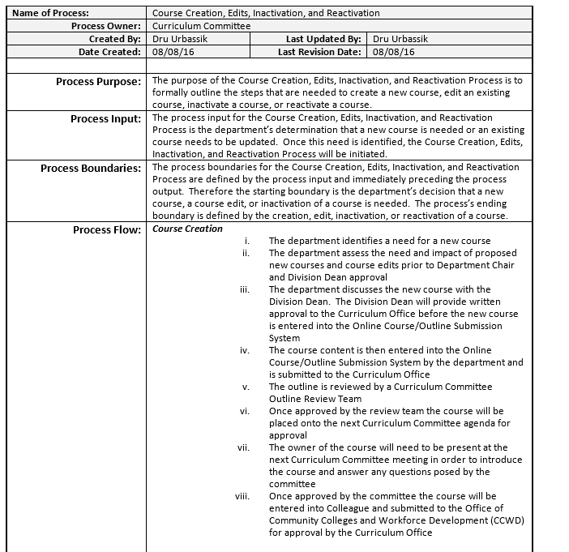
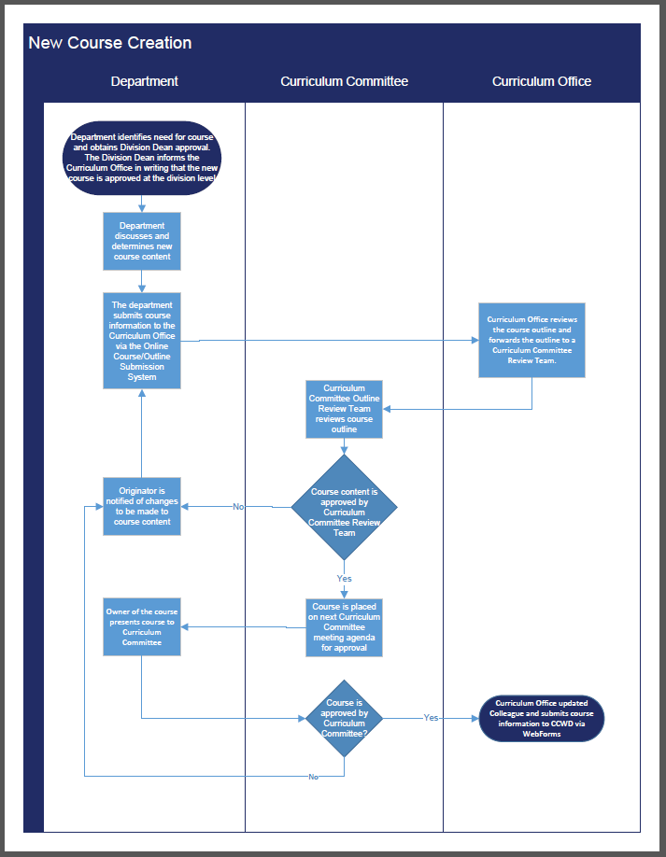
Process Documents
Curriculum Committee started the academic year on September 23.
At the next meeting the Curriculum Committee adopted
4 Process documents. These documents come in three forms:

Slide 6
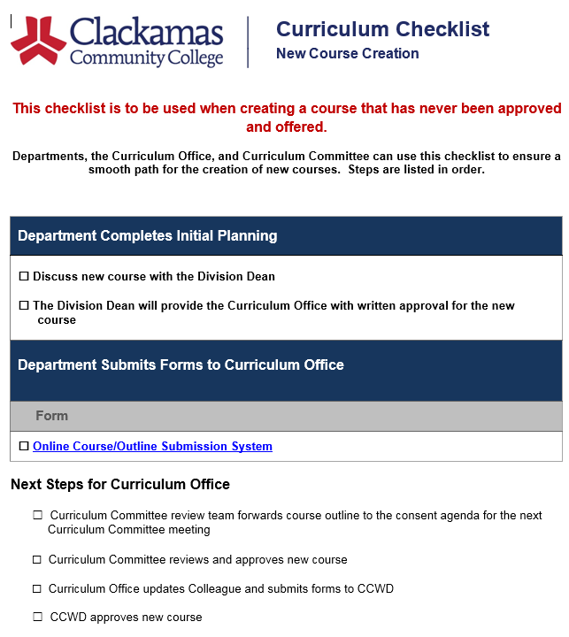
Process Documents

Slide 7
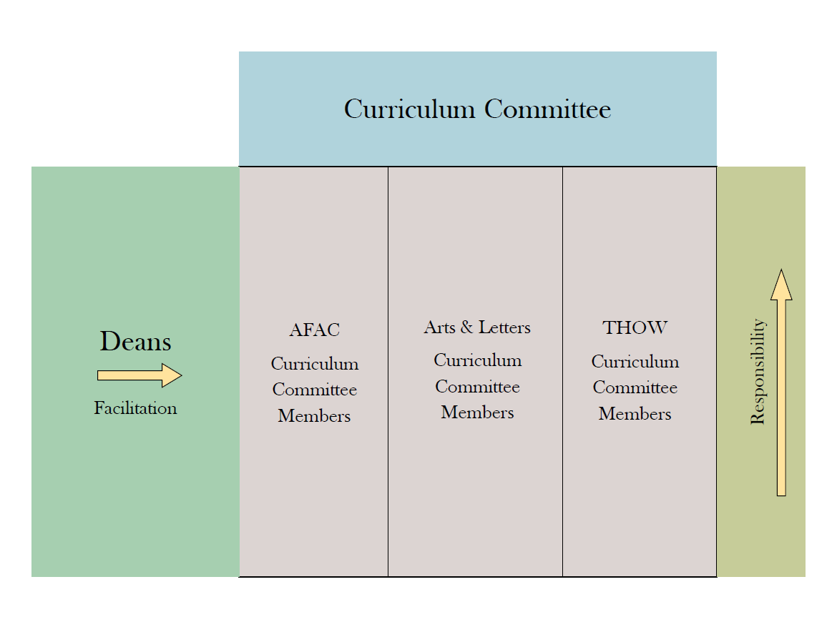
Course Outlines & Review Teams The New Model ☺
AFAC
Curriculum
Committee
Members
Arts & Letters
Curriculum
Committee
Members
TAPS
Curriculum
Committee
Members

Slide 8
All course outlines are reviewed every five years.
Cycle 1, Year One (2011-12)
Cycle 1, Year Two (2012-13)
Cycle 1, Year Three (2013-14)
Cycle 1,Year Four (2014-15)
Cycle 1, Year Five (2015-16)
Cycle 2, Year One (2016-17)
Cycle 2, Year Two (2017-18)
Cycle 2, Year Three (2018-19)
Cycle 2,Year Four (2019-20)
Cycle 2, Year Five (2020-21)
~ 300
Course outlines

Slide 9
Related Instruction
Recommendation #2 from NWCCU states that me must identify outcomes for all CTE programs
Looked at AAOT outlines for guidance
Survey was conducted and as a result of the survey these are the outcomes for CTE related instruction
Computation (1 course)
Use appropriate mathematics to solve problems.
Communication (1 course)
Read effectively, think critically, and write purposefully and capably for professional
audiences.
Human Relations (1 course)
Engage in ethical human interactions that accomplish goals.
Physical Education/Health/Safety/First Aid (3 credits)
Use effective life skills to improve and maintain mental and physical wellbeing.

Slide 10
Also, concerning Related Instruction
Related Instruction Certification process document
With complimentary flowchart and checklist
General Education Certification process document
With complimentary flowchart and checklist

Slide 11
Coming in 2017-18
1. Some course outlines that received General Education Certification
from the Curriculum Committee, are transferring as electives,
but may not fulfill General Education requirements at the transfer
institution.
This will (probably) require revisiting all General Education
courses and perhaps new rules of recertification.
Math-50 will soon be 4 credits. This change will affect multiple programs,
which will have to be updated during the 2017-18 academic year.
Program amendments are scheduled to be complete by January 2018
in order to reflect the credit hour change in all impacted programs
as of Summer 2018.
3. Current language on some course outlines specify “or placement in RD-115.”
The current placement test does not place students in RD-115, so
discussions about RD-115 and course outline boilerplate language
are being held.

